Slide 1
Using Subqueries to Perform Advanced Querying
Search Based on Unknown Values
Compare a Value with Unknown Values
Search Based on the Existence of Records
Generate Output Using Correlated Subqueries
Filter Grouped Data Within Subqueries
Perform Multiple-Level Subqueries

Slide 2

Outer Queries
Outer query
Depends on the values returned by this query

Slide 3

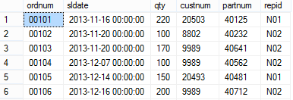
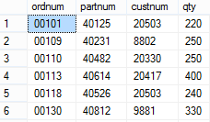
Subqueries
The unknown value is returned to the outer query
Outer query
Subquery
Opening parenthesis
Closing parenthesis
Can return a computed value
Sales
Results

Slide 4




The IN Operator
Search value specified before IN operator
Used in search condition
Searches for list of values returned
Can be column name or constant value
Customers
Sales
Results

Slide 5

Modified Comparison Operators
Function of comparison operator changed by using ANY
Logical operator (always used with a comparison operator)
Specify value before operator
Minimum value for comparison

Slide 6

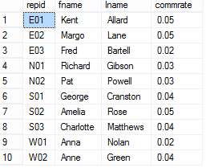

Modified Comparison Operators: Results
Sales
Slspers
Results

Slide 7

The EXISTS Operator
Values not specified
Used in condition of outer query
Checks only for existence of records
Condition tested
Asterisk instead of column names

Slide 8
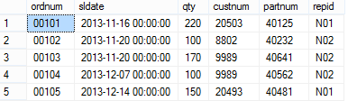
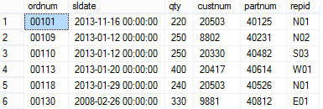
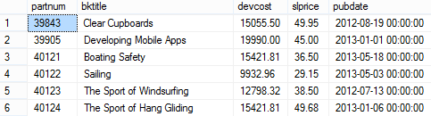
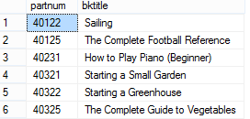
The EXISTS Operator: Results
Sales
Exists = True
Titles
Results

Slide 9
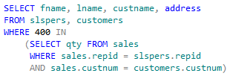
Correlated Subqueries
Depends on input from outer query
Always a constant value
Outer query
Correlated subquery
Located in the WHERE clause
Executed simultaneously for each record targeted for display

Slide 10
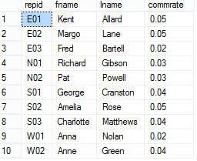
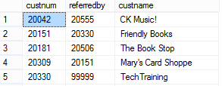
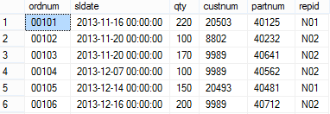

Correlated Subqueries: Results
Slspers
Customers
Sales
Results

Slide 11
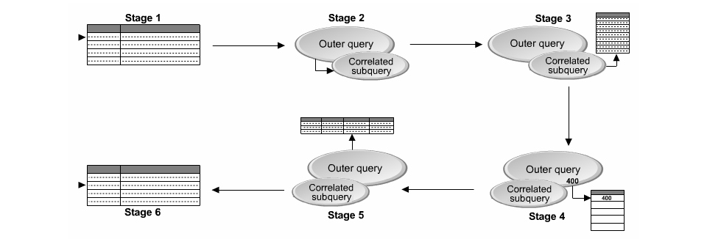
Process of Correlating Queries

Slide 12

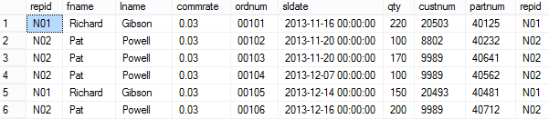
The APPLY Operator
The APPLY operator
Enables you to apply a table expression to all rows of an outer table
WHERE clause
Results

Slide 13

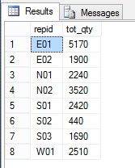
The GROUP BY Clause
Aggregate function returns summary values for groups
Column alias
Grouping is based on the repid column
Results grouped by sales representative ID

Slide 14

The HAVING Clause
Aggregate function
HAVING clause used with the GROUP BY clause
Search condition applied to the aggregate function

Slide 15

Nested Subqueries
Inner query level 1
Nested subqueries
Inner query level 2
Outer query depends on values returned by inner queries
Number of parentheses matches number of inner queries

Slide 16
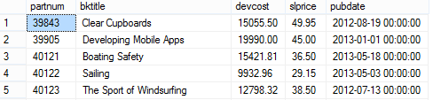
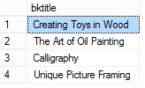
Nested Subqueries: Results
Titles
Customers
Sales
Output of outer query

Slide 17
Reflective Questions
Which type of query do you think would have a longer execution time? Why?
What kind of query do you think would be best to use when you need to retrieve the most intricate details from large records of data?

